Slide 1

Back to School
With Essential Oils
Copyright Modern Wellness, LLC 2014

Slide 2

Disclaimer
I am not diagnosing, treating, or offering any cures to ailments we may discuss.
The information is presented is based on my experiences and research.
I value the medical community when needed.

Slide 3



Back To School Agenda
Essential Oils 101 – Starting with the Basics
Essential Oils 201 – Diving Into Specific Oils
Staying Healthy 101 – Other Helpful Products
Extra Credit – Bonus Items

Slide 4
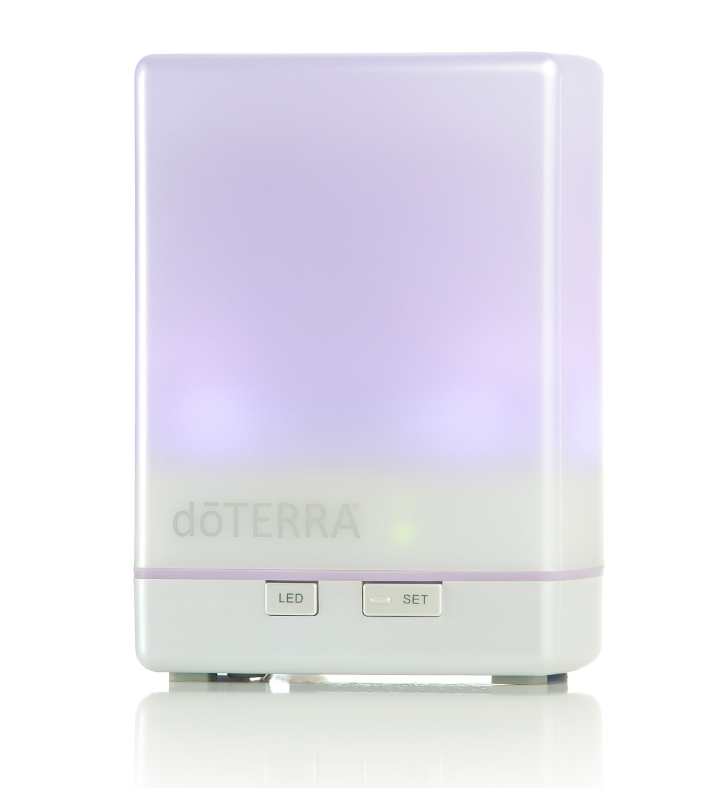


Essential Oils 101
Why use them?
What are they?
Does quality matter?
How do you use them?

Slide 5

Essential Oils 101
Why use essential oils instead of Modern Medicine?
• Made with synthetic chemicals
• Vast amounts of side effects
• Mask Symptoms
• $3.8 Trillion Spent Per Year in the U.S.

Slide 6
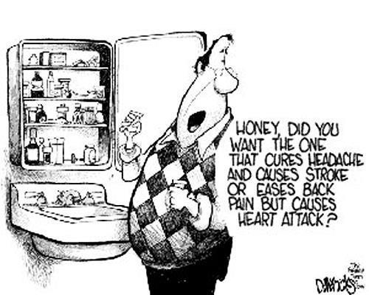
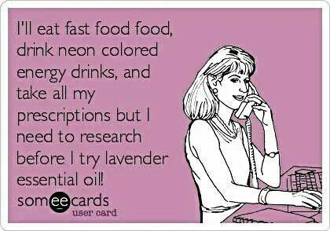
Essential Oils 101
Why use essential oils instead of Modern Medicine?

Slide 7
Essential Oils 101
Being Proactive About Our Own Healthcare
Proactive Healthcare
Healthcare
Informed Self Care
Reduce Toxic Load
Lifestyle
Rest & Manage Stress
Exercise
Eat Right

Slide 8

Essential Oils 101
Why do essential oils work?
Made of hundreds of natural compounds
Works with your body to address the root cause
Extremely safe when used properly
Pennies per drop

Slide 9
Essential Oils 101
What about against Viruses and Bacteria?

Slide 10

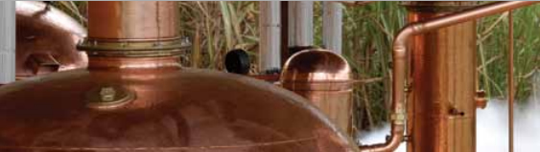

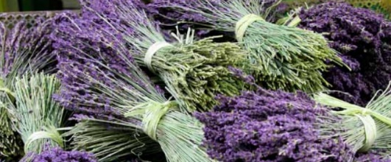
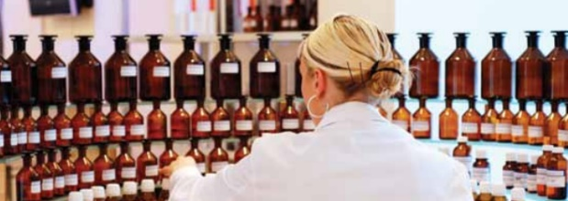
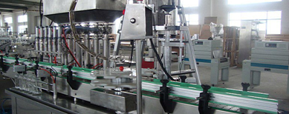
Essential Oils 101
Is there a difference between various brands?
YES!
Where are they grown?
Treated with chemicals or pesticides?
Harvested at the right time of year?
Distilled with the right temperature and pressure (no chemicals)?
Thoroughly tested (beyond GC/MS)?
Not tampered with during bottling?

Slide 11

Essential Oils 101
Is there a difference between grades?
Synthetic
Therapeutic
Perfume/Industrial
Health Benefit
Food
GRAS Standard

Slide 12


Essential Oils 101
Certified Pure Therapeutic Grade
Grown in the best soil possible!
No chemicals or pesticides!
Harvested at the most potent time!
Distilled with the right temperature and pressure (no chemicals)!
Thoroughly tested (7 different tests)?
Absolutely pure!
PURE!
POTENT!
SAFE!

Slide 13
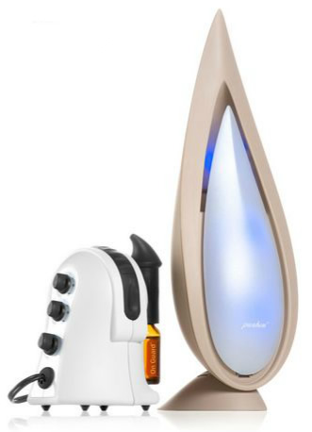


Essential Oils 101
Different ways to use essential oils and the benefits of each
Aromatic
  Affect Mood - including depression
  Kill Germs In The Air
  Open Airways
Topical
  Systemic, localized effects
  Massage
  Immediate Comfort
  Immune Support
Internal
  Take under the tongue, in a gel capsule, or in water
  Relieves issues in the digestive system, mouth, throat, and liver
A
T
I

Slide 14
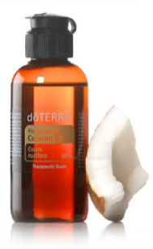
Essential Oils 101
Essential Oil Safety
Very potent
Keep out of eyes, ears, and nose
Dilute with carrier oil, not water
Follow all label directions
N
NEAT (can be used with no dilution)
S
SENSITIVE (diluted for sensitive skin)
Fractionated Coconut Oil
D
DILUTE (always dilute when using)

Slide 15


Essential Oils 102
What oils to use to keep your family healthy and happy
WHICH FAMILY DO YOU WANT TO BE?

Slide 16
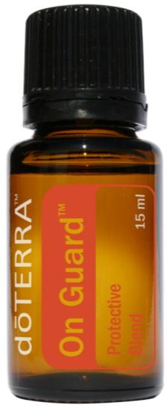




Essential Oils 102
What oils to use to keep your family healthy and happy
Stimulate immune support
Sanitize and protect
Eliminate airborne pathogens and germs
Natural antiseptic
Use as a prevention regimen
Blend includes:
wild orange, clove, cinnamon, eucalyptus and rosemary.

Slide 17
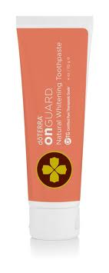
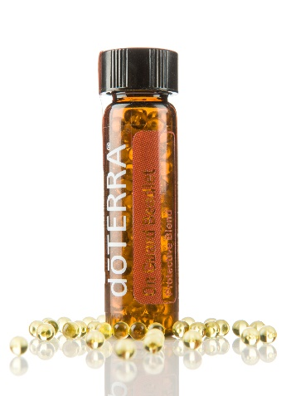
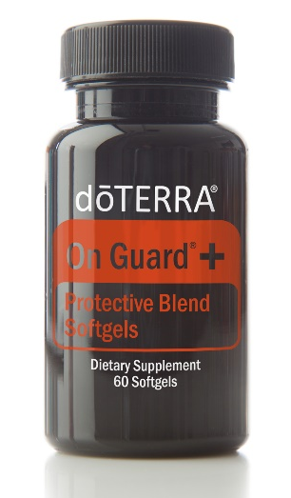
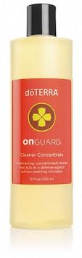
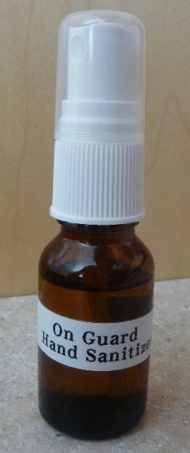
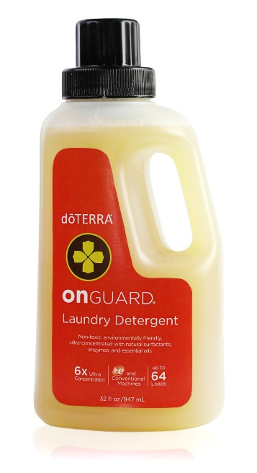
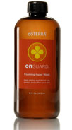

Essential Oils 102
What oils to use to keep your family healthy and happy
** Hand Sanitizer: 15 drops On Guard in 15ml spray bottle. Fill the rest of the way with Fractionated Coconut Oil.

Slide 18
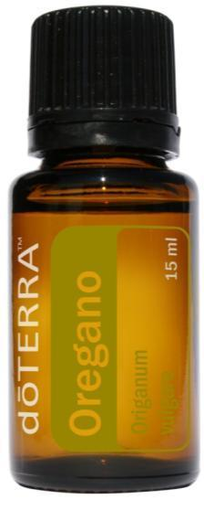

Essential Oils 102
What oils to use to keep your family healthy and happy
Stimulate immune response
Natural defense
Cleanse regimen for GI health
Eliminate warts
“Medicine Cabinet in a Bottle”
Flu Bomb Recipe:
20 drops each of Oregano, Frankincense, Melaleuca, and On Guard + 40 drops Lemon combined in a 10ml roller bottle then topped off with Coconut Oil. Great to apply on the bottom of the feet!

Slide 19
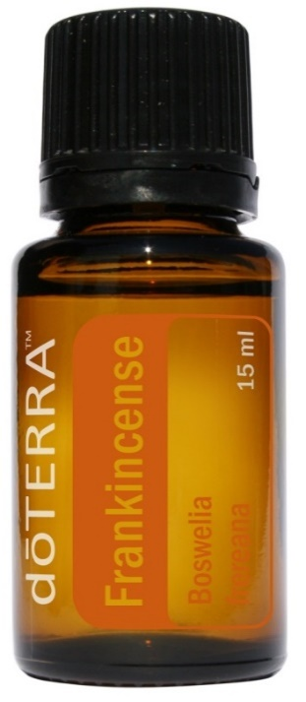

Essential Oils 102
What oils to use to keep your family healthy and happy
Apply to bottom of the feet or use internally to support immune function
Use with Lavender and Peppermint to calm stress and headaches
Depression, anxiety and stress related conditions
Parkinson's, Alzheimer's, Seizures, and Cancer
Anti-Inflammatory

Slide 20
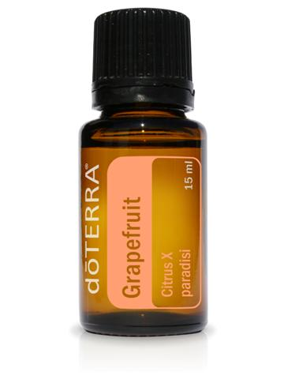
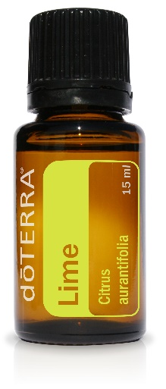
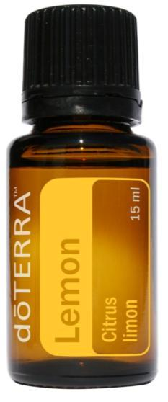
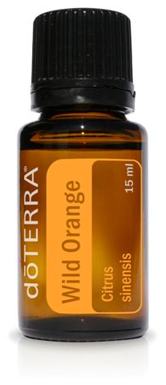
Essential Oils 102
What oils to use to keep your family healthy and happy
Sanitize—eliminate germs, viruses, and microbes
Soothe sore throat
Neutralize odors and reduce toxic stress exposure
Elevate mood
Take internally with water as an antioxidant and detoxifier

Slide 21
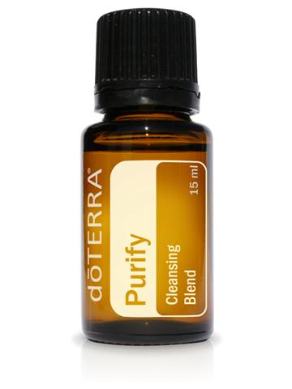
Essential Oils 102
What oils to use to keep your family healthy and happy
Eliminates airborne pathogens
Bacteria & Viruses
Mold and Fungus
Clean cuts and wounds
Neutralizes poisons from insects
Blend Includes: lemon, lime, pine, cilantro, melaleuca, and cintronella

Slide 22
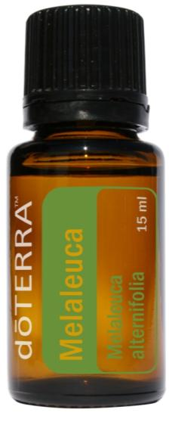
Essential Oils 102
What oils to use to keep your family healthy and happy
Soothe blemishes, rashes, skin irritations
Encourage healthy scalp and hair
Diminish nail and foot fungus (Athlete’s Foot)
Calm cold sores
Control Candida/yeast
Reduce acne
LICE!

Slide 23
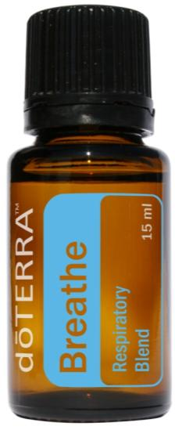
Essential Oils 102
What oils to use to keep your family healthy and happy
Clear lungs and sinuses
Improve respiratory discomfort and congestion
Calm asthma attacks and symptoms
Soothe cold/flu discomfort
Calm cough
Blend includes:
Laurel leaf, peppermint, eucalyptus, melaleuca, lemon and ravensara.

Slide 24
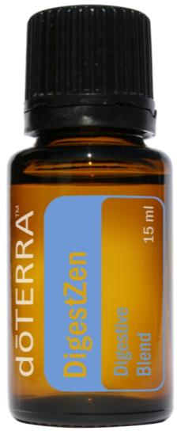
Essential Oils 102
What oils to use to keep your family healthy and happy
Ease stomach and digestive discomfort
Relieve nausea and motion sickness
Calm heartburn and acid reflux
Support healthy, comfortable digestion
Ease digestive issues
Blend includes: Ginger, peppermint, tarragon, fennel, caraway, coriander and anise.

Slide 25
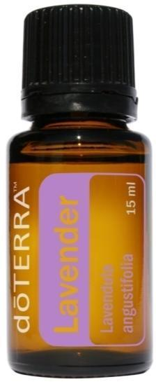
Essential Oils 102
What oils to use to keep your family healthy and happy
Calm anxiety and soothe emotions
Reduce stress and encourage a restful sleep
Soothe and cleanse irritated skin, scrapes, and wounds
Neutralize insect bites/stings
Regenerate burns and damaged skin
** Combine with Lemon and Peppermint to fight allergies.

Slide 26
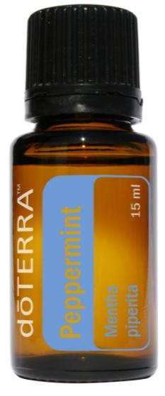
Essential Oils 102
What oils to use to keep your family healthy and happy
Reduce body temperature
Invigorate lungs, open airways, reduce chest congestion
Calm headaches and cough
Energize and invigorate
Ease digestive complaints
Improve mental alertness/focus
** Favorite diffuser combo = Peppermint + Wild Orange!

Slide 27
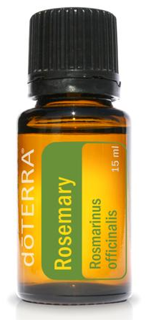
Essential Oils 102
What oils to use to keep your family healthy and happy
Memory retention and recall
Headaches
Constipation
Flu
Healthy Scalp & Hair
**Great to diffuse with Peppermint during homework for energizing + memory retention

Slide 28
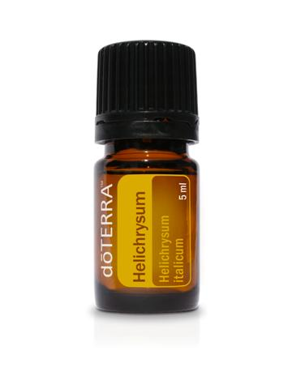
Essential Oils 102
What oils to use to keep your family healthy and happy
Abscess Tooth
Cuts and bleeding
Dermatitis and Eczema
Shock
Conked Heads!

Slide 29
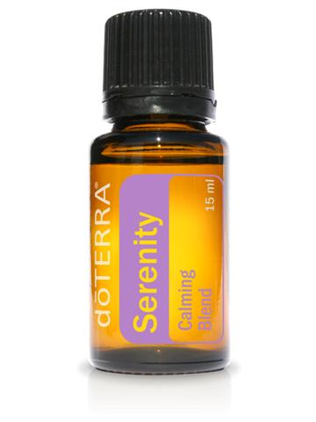
Essential Oils 102
What oils to use to keep your family healthy and happy
ADD/ADHD
Anxiety, Hyperactivity, and Stress
Calming
Insomnia and sleeplessness
Blend includes: Lavender, sweet marjoram, roman chamomile, ylang ylang, sandalwood and vanilla bean.
** Cedarwood is also fantastic for sleeplessness!

Slide 30
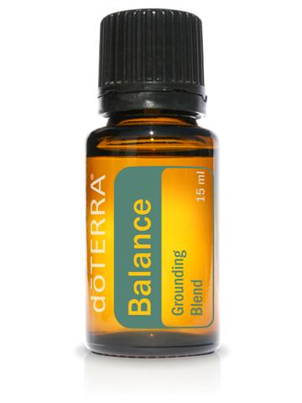
Essential Oils 102
What oils to use to keep your family healthy and happy
Balance electrical energies in the body
Aids with Anxiety, Attention Deficit
Hyperactivity, Nervousness
Promote tranquility and a sense of balance
Blend includes: Spruce, rosewood, frankincense and blue tansy.

Slide 31
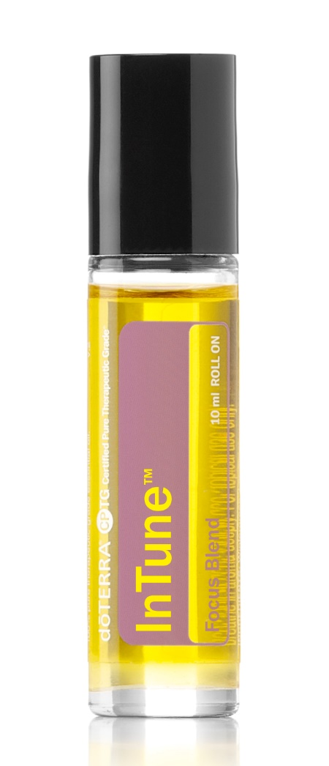
Essential Oils 102
What oils to use to keep your family healthy and happy
Promotes calmness, focus, and balance
Clarity and concentration
ADD/ADHD
Anxiety
Stress
Blend includes: Amyris, Patchouli, Frankincense, Lime, Ylang Ylang, Sandalwood, and Roman Chamomile
**Personal favorite for anxiety & focus issues!

Slide 32
Staying Healthy 101
What other products will help keep your family healthy?
Don’t neglect the Lifestyle components of the Wellness Pyramid!
Reduce Toxic Load
Rest & Manage Stress
Exercise
Eat Right

Slide 33
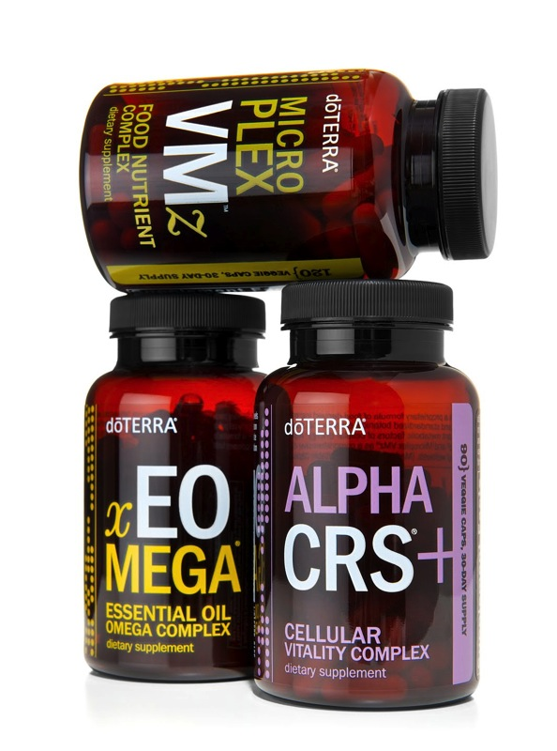
Staying Healthy 101
What other products will help keep your family healthy?
Supports energy production
Supports healthy brain function
Helps reduce inflammation & Pain
Provides 22 essential vitamins and minerals
Supports healthy digestion
Promotes cardiovascular health
Promotes healthy skin
Supports healthy immune function
Fights free radicals

Slide 34

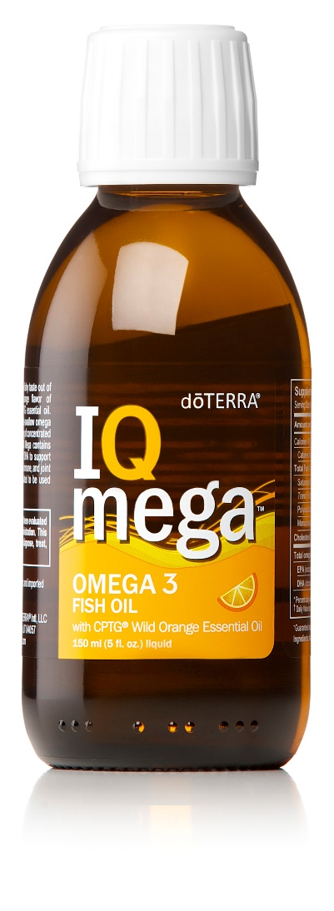
Staying Healthy 101
What other products will help keep your family healthy?
Supports energy production
Supports healthy brain, cardiovascular, immune, digestive, and joint function
Supports healthy cell development & longevity
Whole-food complex
Fights free radicals
No HFCS, Artificial Colors, Sweeteners or flavors

Slide 35


Extra Credit
Tips and products to make your life easier!
Don’t forget to create a Family Password!
Plan out lunches ahead of time so they are healthy!

Slide 36

Extra Credit
Tips and products to make your life easier!
This book will help you become an essential oil expert!
Household tips
Ailments reference guide
Safety information
and more…
You can purchase it from www.aromatools.com

Slide 37

Extra Credit
Tips and products to make your life easier!
Contents:
Heal Emotions with Essential Oils
Oil Descriptions
Why purity matters and more…
You can purchase it from www.aromatools.com

Slide 38
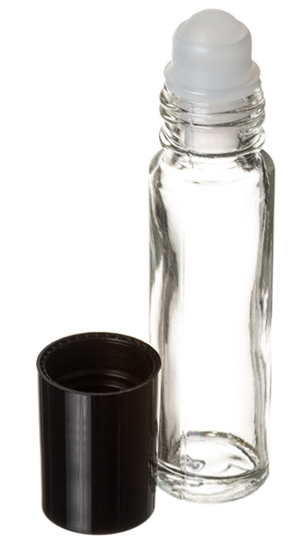
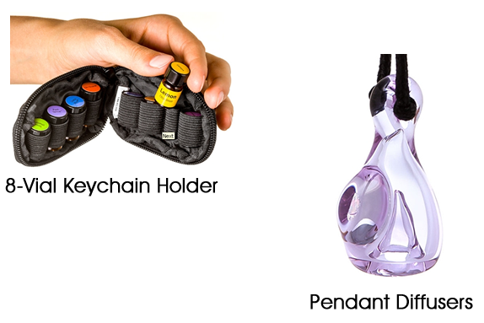
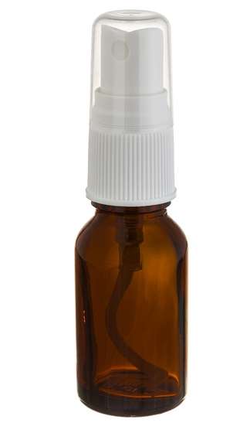
Extra Credit
Tips and products to make your life easier!
Roll On Bottles
Spray Bottles
You can purchase from www.aromatools.com

Slide 39
Extra Credit
How to get started with Essential Oils!
Infectious diseases account for millions of school days lost each year for kindergarten through 12th-grade public school students in the United States:
40% of children aged 5–17 years missed 3 or more school days in the past year because of illness or injury.
Nearly 22 million school days are lost each year due to colds alone.
38 million school days are lost each year due to the influenza virus.
Source: www.cdc.gov/healthyyouth/infectious

Slide 40
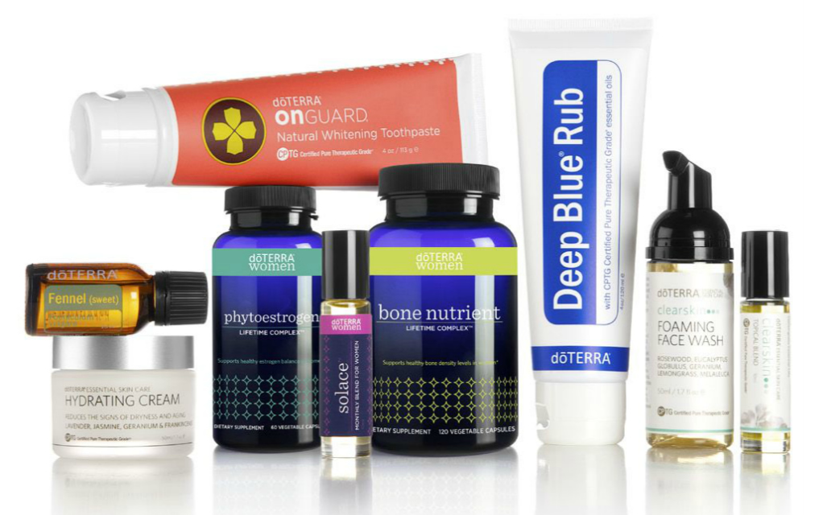
Extra Credit
How to get started with Essential Oils!
Retail Customer
OR
Wholesale Member

Slide 41
Extra Credit
How to get started with Essential Oils!
Huge Savings! 25% Discount off of retail prices
Low Enrollment Fee! Only $35!
Low Renewal Fee! Only $25 and doTERRA will send you a free bottle of peppermint (value $20.50).
Making it only $4.50 each year to maintain your membership.
Loyalty Rewards Program! Earn 10%- 30% on all of your order back in free product, when you participate in the rewards program. Not Required
Members Only Promotions!
Online Account Management!
Business Opportunity - No minimums on orders or any requirements to participate in the business opportunity doTERRA offers. Not Required
Team Pages – Guidance and help from a vast amount of knowledgeable people!
You can enjoy wholesale membership without any strings attached!

Slide 42
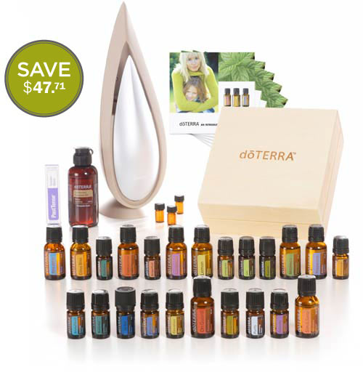
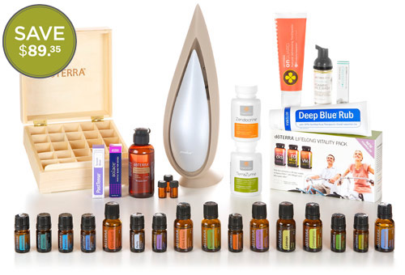
Extra Credit
How to get started with Essential Oils!
NO $35 enrollment fee
Product discounted even lower than wholesale price
A great foundation to start with
Many kits come with extra benefits
Premium Essential Oils Kit
Natural Solutions Kit

Slide 43
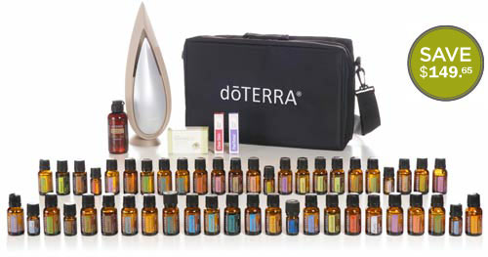
Extra Credit
How to get started with Essential Oils!
Every Oil Kit
You can view all enrollment kits at
www.modernwellness.com/pdf/enrollment-kits.pdf

Slide 44
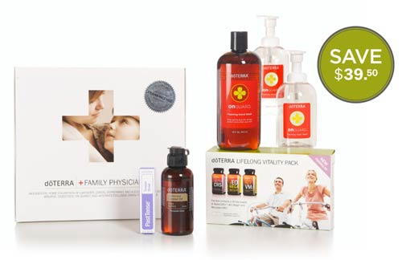
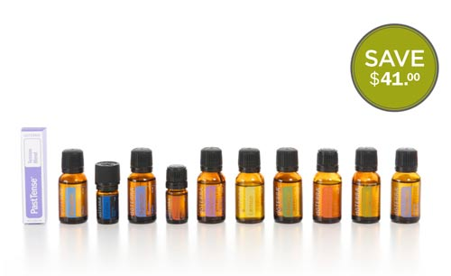
Extra Credit
How to get started with Essential Oils!
Family Wellness Kit
Home Essentials Kit
Enroll Here:
www.modernwellness.com/how-to-enroll-with-doterra

Slide 45

Extra Credit
How to get started with Essential Oils!
Special Membership Offer*
250PV Order =
Free 6th Edition Modern Essentials Book + Free Bottle of InTune Focus Blend (great for school)!
100PV Order =
$50 in Free Oils of your choice!
*Expires Friday August 15th!

Slide 46

Don’t Wait Until It’s Too Late!
Get Started Today!

Slide 47





Connect With Us
It’s so easy to get started!
801-448-6531
behealthy@modern-wellness.com
www.modernwellness.com
www.youtube.com/ModernWellness
www.facebook.com/ModernWellnessForYou
twitter.com/ModernWellnessU
pinterest.com/modernwellness
Enroll Here:
www.modernwellness.com/how-to-enroll-with-doterra

Slide 48




Why doTERRA?
Can you really make money sharing essential oils?
65%
Retention Rate
Notes:
What makes doTERRA different?
doTERRA is part of a very rapidly growing billion dollar industry. People are flocking to natural health and turning a healthier way of living. These products are in demand. There are several things that set doTERRA apart from other companies though. First, it’s their products! The quality is the best you can get and they work so it isn’t a hard sell. This isn’t like selling make-up or jewelry, this is teaching people how to take control of their healthcare.
Because of their amazing products, doTERRA has become the world’s largest Essential Oil Company in just 6 years! Those are all amazing things but the one thing that really got my attention about this particular company is the founders. I’ve worked in and owned serveral businesses over the past 20 years. When I decided that I wanted out of the web development world and this opportunity presented itself I knew the type of people I wanted to partner with. There was no question that I had found people with honestly and integrity when it came to doTERRA’s founders. They are the best kind of people. For those of you who really love numbers though and want to see what this looks like long-term let me just tell you that the industry standard for retaining customers is around 11%. That means that only 11% of the people that have purchased, purchase again. Would you like to know what doTERRA’s average retention rate is? (CLICK) That is solid retention. You’re not having to build from the ground up every month, which helps you reach higher income levels faster if you’re doing it right.
Let’s talk about some more numbers. Last but not least, their compensation plan is unparalleled. They promote team building instead of greed. The more you help the people below you, the better off you are!

Slide 49
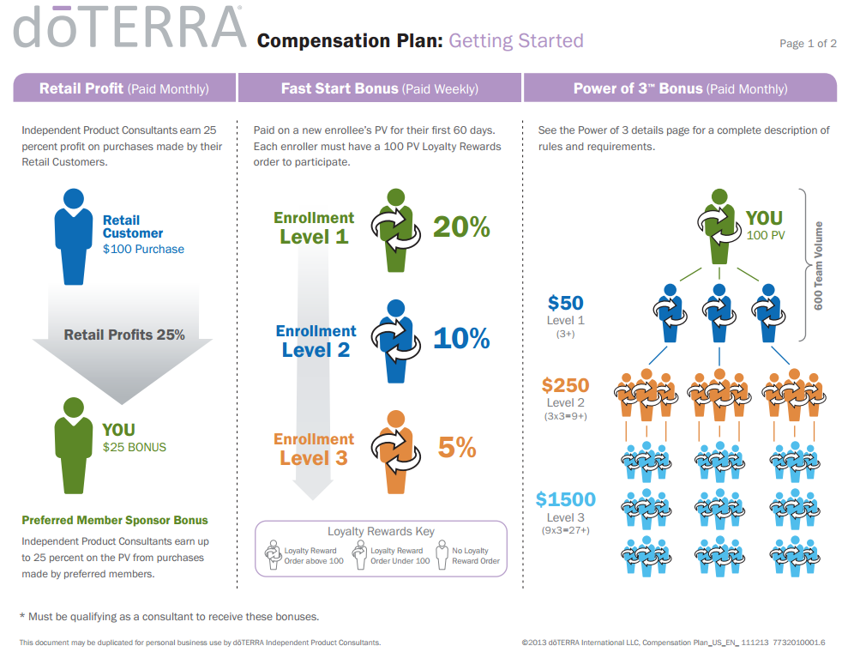

Slide 50
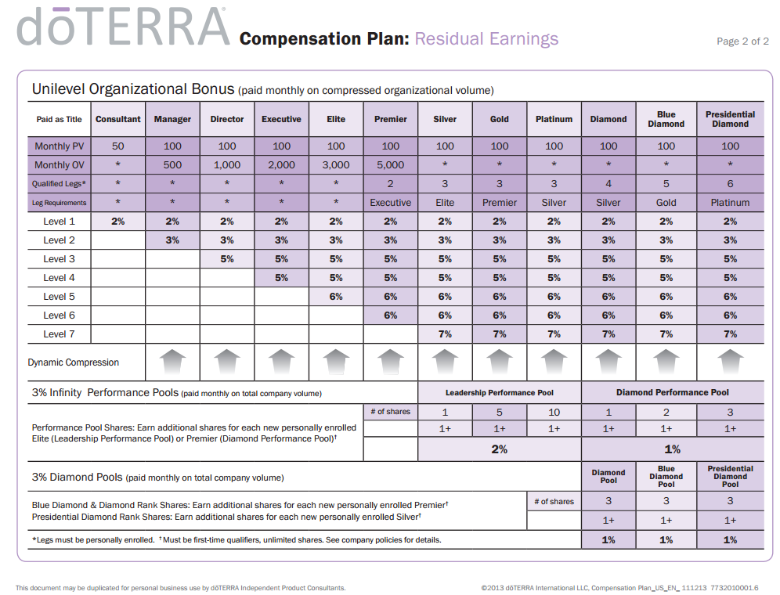

Slide 51
Why doTERRA?
Average Leadership Income for 2013
Rank | Average Annual Earnings | Percent of Leaders
Silver | $26,000 | 62%
Gold | $57,000 | 22%
Platinum | $106,000 | 5%
Diamond | $203,000 | 8%
Blue Diamond | $499,000 | 2%
Presidential Diamond | $1,372,000 | 1%

Slide 52
Connect With Us
It’s so easy to get started!
801-448-6531
behealthy@modern-wellness.com
www.modernwellness.com
www.youtube.com/ModernWellness
www.facebook.com/ModernWellnessForYou
twitter.com/ModernWellnessU
pinterest.com/modernwellness
Enroll Here:
www.modernwellness.com/how-to-enroll-with-doterra

