Slide 1
DōTERRA Continued Education Series
Allergies

Slide 2
About us
DōTERRA Continued Education Series

Slide 3
Todays Topic
Natural support
For Allergies
DōTERRA Continued Education Series
Notes:
https://www.mayoclinic.org/diseases-conditions/allergies/symptoms-causes/syc-20351497

Slide 4
Resources
The Essential life
Modern Essentials
www.essentialoilsupplies.co.uk
Modern essentials (App)
DōTERRA Continued Education Series

Slide 5
DōTERRA Continued Education Series

Slide 6
DōTERRA Continued Education Series

Slide 7
CPTG
Testing
Co impact Sourcing
Healing Hands work
DōTERRA Continued Education Series

Slide 8
3 ways to use dōTERRA
DōTERRA Continued Education Series

Slide 9
What causes an Allergic Reaction?
An allergic reaction begins in the immune system.
An allergen is a substance that tricks the immune system — making it think that the allergen is an invader.
Immune system produces antibodies – cells – release histamine - causing the allergic reaction
This results in: Inflammation of skin, sinuses, airways or digestive system.
DōTERRA Continued Education Series
Notes:
The immune system then overreacts to the allergen, which is really a harmless substance, and produces Immunoglobulin E antibodies. These antibodies travel to cells that release histamine and other chemicals,

Slide 10
Why are allergies on the rise?
High Inflammation and Over active Immune System
A lot of our bodies are already dealing with High Inflammation (root of all disease) and an immune system that is in overdrive.
This results in an overreaction to an allergen
If the immune system and inflammation within the body was balanced, the reaction to the allergen would be normal; however, today these reactions are exaggerated and lead to the next unneeded allergic reaction.
DōTERRA Continued Education Series
Notes:
The question here still remains — if these common causes have been around for thousands of years, then why have the allergy rates increased in recent history?
One of the theories behind explaining the increase in allergies has to do with inflammation, the root of most diseases.
The body responds in a certain way to an allergen because the immune system is in overdrive – due to the fact the body is already dealing with high inflammation.
When the body is already dealing with high inflammation, any allergen sets off an increased reaction. That means that when the body’s immune system is overworked and stressed, introducing an allergen sends the body into overreaction.

Slide 11
Natural Alternatives
Nutrition – local honey, nettle tea, ems vit c supplement, anti-inflammatory foods, ginger and turmeric– LLV – digestive enzymes, zendocrine complex
Essential oils!
DōTERRA Continued Education Series

Slide 12
What can cause allergies
DōTERRA Continued Education Series

Slide 13
Did you know
Hay fever affects 10%- 30% of adults in the UK and as many as 40% of children (that’s around 18 million people!)
1 in 4 people suffer with hay fever
1 in 5 people in the UK have to take time off work due to hay fever
Also-
71% of sufferers reported higher tan average stress levels
75% wanted a more natural treatment
DōTERRA Continued Education Series

Slide 14
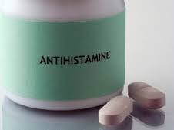
Problems with current Medicines
Long term use of antihistamines have been
Linked with-
Headaches, sleepiness, rashes, behavioral problems
in children, convulsions, depression,
Dementia and more!
DōTERRA Continued Education Series

Slide 15
Typical food triggers to explore
Milk
Wheat
Nuts
Chocolate
Coffee
Alcohol
Sulphites
Eggs
Shellfish
Nuts
Artificial colourings
Nightshades
Citrus fruits
Strawberries
DōTERRA Continued Education Series

Slide 16
Natural Alternatives
Lots of water
Raw local honey
Fruit juices (not citrus)
Brown rice
Lean meats
Fish (not shellfish)
Almonds, walnuts, sunflower seeds
Anti inflammatory herbs and spices- Turmeric, ginger, cayenne, garlic
Cleansing teas- nettle, green tea
DōTERRA Continued Education Series

Slide 17
Anti inflammatory herbs and spices
DōTERRA Continued Education Series

Slide 18
Supplementation
doTERRA
Lifelong vitality kit
DōTERRA Continued Education Series

Slide 19
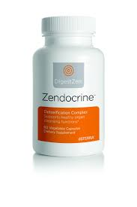
Supplementation continued
Zendocrine complex
Supports vital cleansing organs
PB assist replenishes gut flora
DōTERRA Continued Education Series

Slide 20
Notes:
To help your children maintain healthy bodies, doTERRA has created a children’s supplement line. The doTERRA® children’s line includes daily vitamins, omegas, and a probiotic supplement. These products have been specifically formulated to benefit younger bodies.
Let’s take look at these products now.

Slide 21
How do Essential oils fight allergens?
They can Reduce Inflammation and boost the immune system
help to detoxify the body
Fight infections, bacteria, parasites, microorganisms and harmful toxins.
Aniti-histamaine effects
They reduce the bodies susceptibility to outside sources and reduce the overreaction of the immune system when it is faced with a harmless intruder
relieve respiratory conditions and increase sweat and urination — helping with the elimination of toxins.
DōTERRA Continued Education Series
Notes:
People who suffer from allergies are often told to avoid triggers, but that is nearly impossible when the seasons are changing and our immune systems are impaired by the food industry and environmental toxins. Thankfully, some powerful essential oils serve as a natural and safe way to treat the symptoms of allergies and boost our immune systems. These essential oils for allergies have the ability to chemically support the body and help it to overcome hypersensitivity.
People who suffer from allergies are often told to avoid triggers, but that is nearly impossible when the seasons are changing and our immune systems are impaired by the food industry and environmental toxins. Thankfully, some powerful essential oils serve as a natural and safe way to treat the symptoms of allergies and boost our immune systems. These essential oils for allergies have the ability to chemically support the body and help it to overcome hypersensitivity.
People who suffer from allergies are often told to avoid triggers, but that is nearly impossible when the seasons are changing and our immune systems are impaired by the food industry and environmental toxins. Thankfully, some powerful essential oils serve as a natural and safe way to treat the symptoms of allergies and boost our immune systems. These essential oils for allergies have the ability to chemically support the body and help it to overcome hypersensitivity.
Antihistamines are most commonly used to control the symptoms of allergies such as hay fever.
In these conditions they work by preventing the actions of histamine, which is a substance produced by the body as part of its natural defences.
It's stored in cells called mast cells, in almost all tissues of the body, and is released when the body reacts to a foreign substance (known as an allergen).

Slide 22
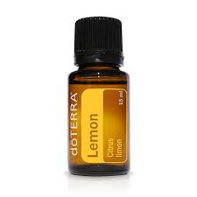
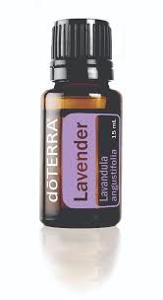
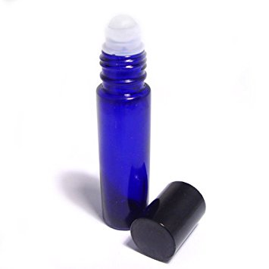
Allergy Trio
Children: 10 drops of each In a 10ml roller bottle topped up with coconut oil
DōTERRA Continued Education Series

Slide 23
Lavender
Lavender is a natural antihistamine and anti-inflammatory. Great to use during a reaction
Use topically to soothe and calm skin irritations such as insect bites or hives.
Diffuse lavender to reduce inflammation in bronchial tubes.
Use lavender in lotions, bath salts, lip balms, and more.
DōTERRA Continued Education Series

Slide 24
lemon
Lemon oil supports lymphatic system drainage and helps with overcoming respiratory conditions.
Studies have shown that lemon essential oil inhibits the growth of bacteria and boosts the immune system.
When diffused at home, lemon oil can kill bacteria and eliminate allergy triggers in the air.
Disinfect your home. It will remove bacteria, pollutants and allergens from outside
Add lemon oil to your laundry detergent, mix a couple of drops with water and spray it on your couches, sheets, curtains and carpets.
DōTERRA Continued Education Series
Notes:
Make a spray to cleanse your home

Slide 25
Peppermint
Inhaling diffused peppermint oil can immediately unclog the sinuses and offer relief to scratchy throats.
Peppermint acts as an expectorant and provides relief for allergies, as well as colds, coughs, sinusitis, asthma and bronchitis.
It has the power to discharge phlegm and reduce inflammation — a leading cause of allergic reactions.
DōTERRA Continued Education Series

Slide 26
Peppermint Studies
A 2010 study published in the Journal of Ethnopharmacology investigated the effects of peppermint oil in the tracheal rings of rats. The results suggest that peppermint oil is a relaxant and exhibits antispasmodic activity, inhibiting contractions that causes you to cough.
Another study published in the European Journal of Medical Research suggests that peppermint oil treatment has anti-inflammatory effects — reducing the symptoms of chronic inflammatory disorders such as allergic rhinitis and bronchial asthma.
DōTERRA Continued Education Series
Notes:
Studies from Dr Axe: https://draxe.com/essential-oils-for-allergies/

Slide 27
Hay Fever Support
Blend 2 drops each of lavender, lemon, and peppermint oil in 1 tsp (5ml) of Fractionated Coconut oil, and apply a small amount on the temples, under the nose, and on the bottoms of the feet morning and evening.
Also diffuse, use in a roller bottle or take a shot!
OTHER OILS TO TRY-
Melissa- natural anti histamine
Eucalyptus-opens lungs and sinuses
Basil- supports adrenals
Roman Chamomile- soothing
DōTERRA Continued Education Series

Slide 28
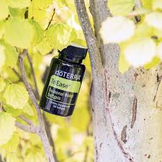
For convenience
DōTERRA Continued Education Series

Slide 29
Breathe
A
T
Blocked noses
Chesty Coughs
Congestion
Croup
Asthma
Breathe vapor stick
Breathe throat drops

Slide 30
Homemade nasal rub
Ingredients
1 tablespoon beeswax pellets
2 tablespoons coconut oil
4 drops steam distilled lemon essential oil
4 drops lavender essential oil
4 drops peppermint essential oil
DōTERRA Continued Education Series

Slide 31
Emily's Top tips for Hay Fever Support
Nasal inhaler
Soothing infused bath
Soft
scented tissues
Quercetin, bromelain and Vit C
Nettle tea
Shades!
DōTERRA Continued Education Series

Slide 32
Fiona's testimonial
I was introduced to the wonderful DōTERRA oils a year ago. My younger son, 3 yrs. old at the time, appeared to be unwell with runny nose sore eyes not sleeping etc. for about 3 months. I was using over the counter calpol and antihistamines but nothing seemed to work for him. So We tried lemon, lavender and peppermint (antihistamine blend) 1 drop of each oil on the bottom of his feet 3 time a day for 2 weeks along side on guard in a diffuser to boost his immune system as often as I could when he was home. Within 2 weeks I had a different child. He was sleeping better and was a happier little boy.
Fiona Nichols
DōTERRA Continued Education Series

Slide 33
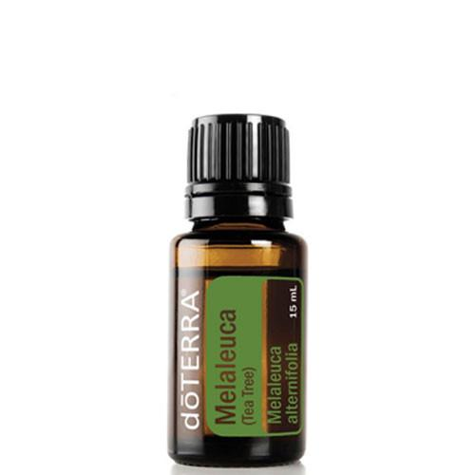
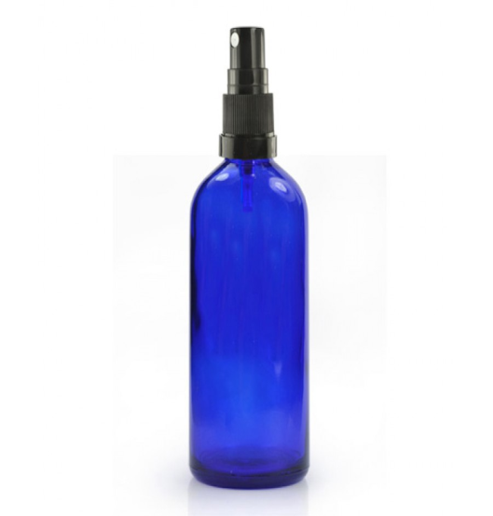
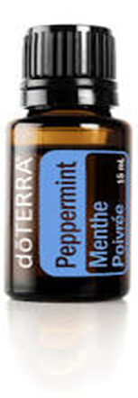
Insect Allergy Support
An insect sting allergy can cause:
A large area of swelling (oedema) at the sting site
Itching or hives all over the body
Cough, chest tightness, wheezing or shortness of breath
Anaphylaxis
ALLERGY TRIO
DōTERRA Continued Education Series
Notes:
Tea Tree Oil
This powerful oil can destroy airborne pathogens that cause allergies. Diffusing tea tree oil in the home will kill mould, bacteria and fungi. It is an antiseptic agent and it has anti-inflammatory properties.
A 2000 study conducted in Germany found that tea tree oil exhibits antimicrobial activity against a wide range of bacteria, yeasts and fungi. These microbes lead to inflammation and force our immune system to work on overdrive. (10)

Slide 34
Types of Allergies
Animal Allergy:
Sneezing or a runny or stuffy nose.
Facial pain (from nasal congestion)
Coughing, chest tightness, shortness of breath and wheezing.
Watery, red or itchy eyes.
Skin rash or hives.
Facial Steaming with melaleuca/Lavender! 2 drops In a bowl of water. 2-3 times daily!
DōTERRA Continued Education Series

Slide 35
Allergy to Cat fur Testimonial
I have an allergic reaction to cats, which my body always presents as an asthmatic reaction. The severity of asthma varies from “medium” to “severe”, with symptoms starting within 15-20 mins of exposure and lasting typically for several days.
For years, I have treated this allergic reaction with a salbutamol inhaler, which I inhale as soon as I feel the onset of asthma and repeat every few hours during the “attack”. Whilst this treatment minimises the effects of the asthma and helps me to breathe, my body feels as though it’s shaking from within and my hands sometime look as if I have onset Parkinson's.
I first tried the oils for this condition by accident when I found myself in a house with a cat and no inhaler. I drank two drops each of lemon, lavender and peppermint in some water. I then applied a drop of Breathe to my jawline and over the bridge of my nose - positions close to my nasal passage in order that I could inhale it.
When we left, a good 3 hours after arriving, I still wasn’t feeling any symptoms of asthma. The following morning, I went to the gym. This is always my “test” to see if there is any residual wheezing, as, when I exert myself physically, I can tell if my respiratory system is “normal’ or compromised. I had absolutely no effects of asthma at all. I was literally blown away. I know my body and I know how strongly it reacts to cats …. so long salbutamol inhaler!
Melanie Waite
DōTERRA Continued Education Series

Slide 36
Food Allergies
Zengest: Ginger, peppermint, tarragon, fennel, caraway, coriander and anise
“I also have a older son who has multiple food allergies and constantly had tummy ache. We used diluted zengest (5 drops) in a 10ml roller ball on his tummy as often as he needed which seemed to really help him and introduced doTERRA’s probiotics and multi vitamins. His tummy aches have lessoned which is amazing. I wouldn’t be without DōTERRA oils in my life now.”
Fiona Nichols
DōTERRA Continued Education Series
Notes:
1-2 drops of Lemon or Peppermint internally in water
1-2 drops of Lemon or Peppermint internally in water

Slide 37
Skin allergies
Atopic dermatitis, an allergic skin condition also called eczema, can cause skin to:
Itch
Redden
Flake or peel
Itchy skin salve-
½ cup Organic Shea butter
½ cup Organic coconut oil
Optional ¼ raw virgin olive/almond oil
1TB local honey
30 drops lavender essential oil
8 drops Melissa
Optional extra- 5 drops geranium and/or myrrh
DōTERRA Continued Education Series

Slide 38
Skin soothers
Spray-
10 drops Lavender
10 drops Roman Chamomile
Top with distilled water
Cool compress-
Fill basin with 2 drops of Frankincense, Chamomile, Helychrism (or other chosen oil) soak flannel, wring out and hold on affected area for relief
2-3 x per day or as needed
DōTERRA Continued Education Series

Slide 39
Anti inflammatory smoothie recipe
2 apples, green 1 cup of pineapple, frozen 2 teaspoon of local raw honey 1 to 2 cups of water
1 drop doTERRA ginger oil
DōTERRA Continued Education Series

Slide 40
A
T
I

Slide 41
Itovi scanner
DōTERRA Continued Education Series

Slide 42
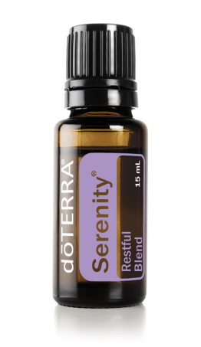
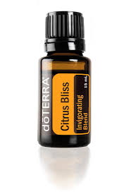
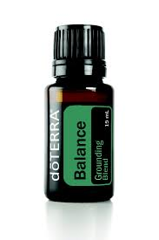
LRP – % you get back in points
Product of the month:
125PV before the 15th
of the month
200 PV Offer
Notes:
You don’t even have to spend 50 pounds to qualify thanks to the pv system where 1 pv = 1 dollar. Each month you spend 50 pv or more, this counts as a ‘qualifying LRP’ month. After you have had three qualifying months you move up to the next level of % as shown on the chart until you reach the maximum % of 30% off your products. This is ontop of the 25% you receive from having a wholesale account.

Slide 43
Why?

Slide 44
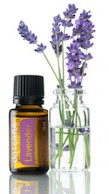
1. The Product!
The ONLY Certified Pure Therapeutic Grade Essential Oil
100% Natural
Similar health benefits to synthetic drugs with NO SIDE EFFECTS or ADDICTIONS
Notes:
Essential Oils are a 100% Natural way to care for our health.
Essential Oils have been used for their medicinal benefits throughout history including in ancient Egypt and China.
Essential Oils have similar properties and benefits as many synthetic medications (in fact many medications are copies of certain compounds in plants or essential oils).
Essential Oils have NO side effects. (The synthetic drugs that copy essential oils are not perfect copies and therefore have side effects).
44

Slide 45
2. Company and Support
doTERRA is one of the fastest growing and most successful companies in the industry- debt free.
Seven Executives consisting of both experienced business leaders and health professionals.
Strong Scientific team consisting of many Doctors, Scientists and other health professionals
Co-Impact Sourcing & Healing Hands
Team Support
Notes:
Co-impact: – doTERRA sources its oils from over 40 countries —more than half of which could be considered developing countries. dōTERRA is committed to the ethical treatment of its suppliers by providing on-time payments at fair prices. They work in partnership with the local farmers.

Slide 46
3. The Financial Benefit!
Residual Income
Very generous Compensation Plan
doTERRA has a 65% Retention Rate vs 13% Industry average!

Slide 47
Business Training
Average Income by Rank

